Slide 1
Environment Variables &
Attacks

Slide 2
Environment Variables
A set of dynamic named values (variable, value pairs)
Their values can be set by the user before a program is run.
-the program then directly or indirectly consume the variables
Part of the operating environment in which a process runs
Affect the way that a running process will behave
Introduced in Unix and also adopted by Microsoft Windows
Example: PATH variable
When a program is executed the shell process will use the environment variable to find where the program is, if the full path is not provided.
Notes:
Most programmers do not realize that environment variables are being used for their program
Nowadays, any OS uses environment variables → most common type is the PATH environment variable (in order to target a different program)
i.e. typing ‘ls’ in shell program.
If command is typed without a path, it checks locally first → then it checks PATH environment variable’s path.
Most often, environment variables are in the background (not visible by default to user).
Also, you can create an alias to a command where your program is located (basically a next rank in the path checking hierarchy so that I can run my custom programs without having to type the path to my program)

Slide 3
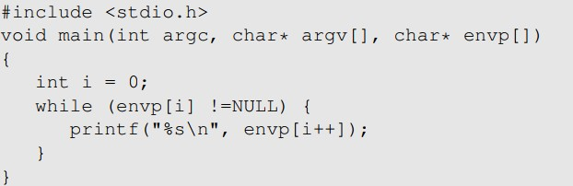
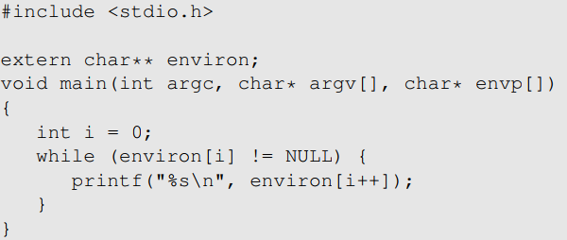
How to Access Environment Variables
From the main function
More reliable way: Using the global variable
Notes:
The variable name envp perhaps stands for “environment process”
Note: extern char** environ says to look for this declared variable name externally (not in the local program); eviron is a system variable, so when you do
extern char** environ
Program will look at global heap for the variable and treat it as a char**

Slide 4
How Does a process get Environment Variables?
Process can get environment variables one of two ways:
If a new process is created using fork() system call, the child process will inherits its parent process’s environment variables.
If a process runs a new program in itself, it typically uses execve() system call. In this scenario, the memory space is overwritten and all old environment variables are lost. → program is run right in the same process (memory space) that called execve()
But also note: execve() can be invoked in a special manner to pass environment variables from one process to another.
Passing environment variables when invoking execve() :
Notes:
What is a system call? → a way to switch from user space (environment) to kernel space (kernel function privileges) via system interrupts. Often times, there is a system call vector storing the names (and paths) of all system calls
Examples:
open()
System()
Fork()
Exec()
Execvp()
Execls()
Etc…

Slide 5
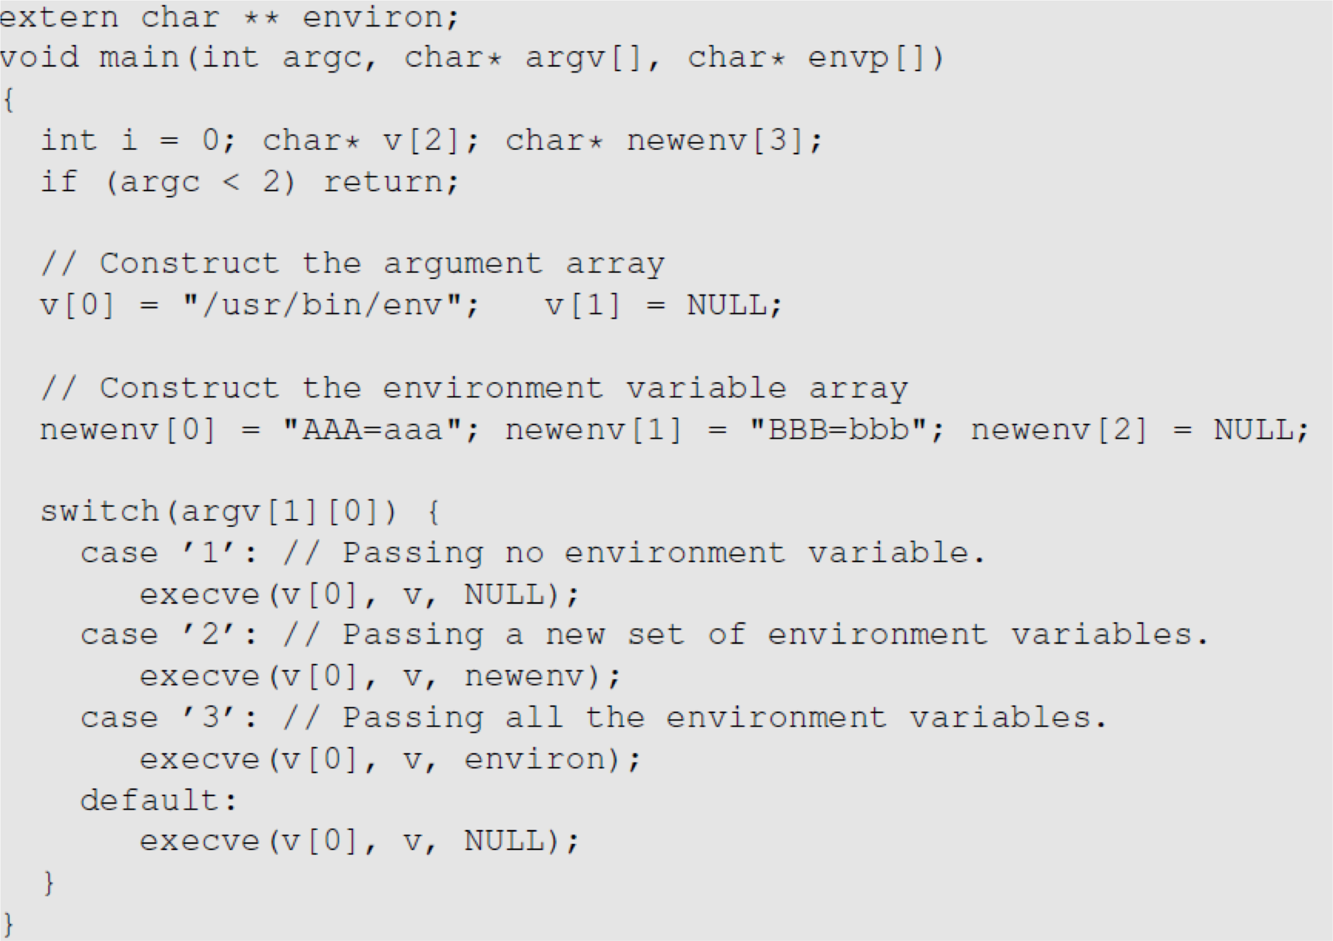
execve() and Environment variables
The program executes a new program
/usr/bin/env, which
prints out the environment variables of the current process.
We construct a new variable newenv, and use it as the 3rd argument.
Notes:
Note: AAA is variable name, aaa is the variable value…etc.

Slide 6
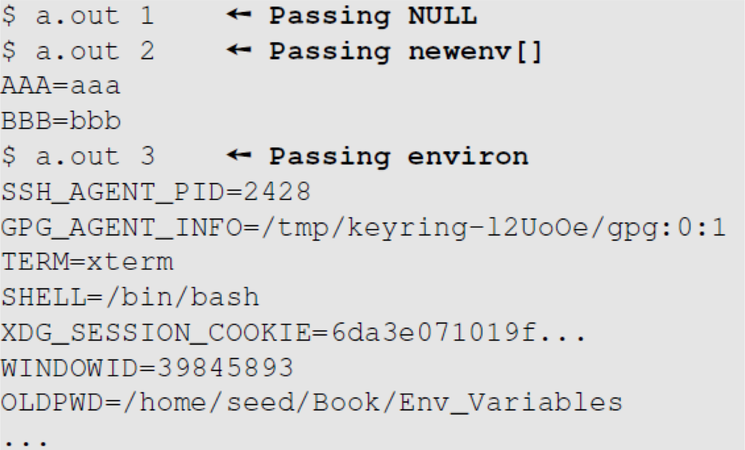
execve() and Environment variables
Obtained from the parent process

Slide 7
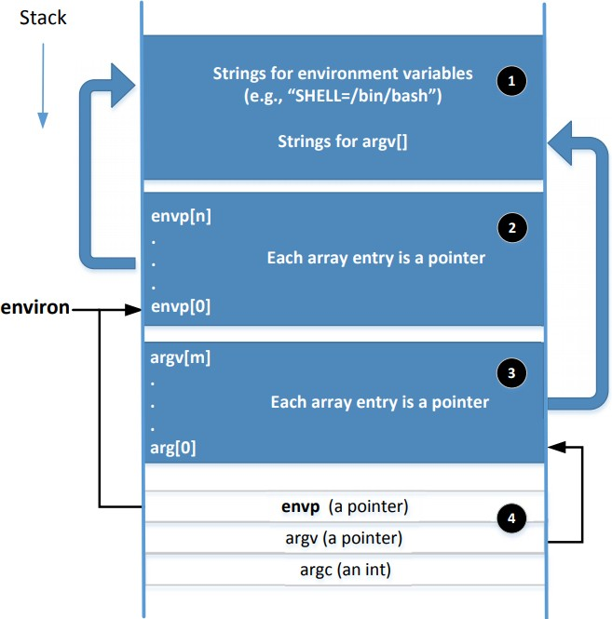
Memory Location for Environment Variables
envp and environ points to the same place initially.
envp is only accessible inside the main function, while environ is a global variable.
When changes are made to the environment variables (e.g., new ones are added), the location for storing the environment variables may be moved to the heap, so environ will change (envp does not change)
Notes:
If local stack for storing environment variables gets too full, it is migrated to the heap.
However envp does not change its pointing location so then you will lose access to the environment variables.

Slide 8
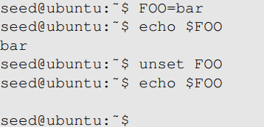
Shell Variables & Environment Variables
People often mistake shell variables and environment variables to be the same.
Shell Variables:
Internal variables used by shell.
Shell provides built-in commands to allow users to create, assign and delete shell variables.
In the example, we create a shell variable called FOO.
Notes:
Shell variables do not have to be all CAPS but that is the convention.

Slide 9
Side Note on The /proc File System
/proc is a virtual file system in linux. It contains a directory for each process, using the process ID as the name of the directory
Each process directory has a virtual file called environ, which contains the environment of the process.
e.g., virtual file /proc/932/environ contains the environment variable of process 932
The command “strings /proc/$$/environ” prints out the environment variable of the current process (shell will replace $$ with its own process ID)
When env program is invoked in a bash shell, it runs in a child process. Therefore, it print out the environment variables of the shell’s child process, not its own.

Slide 10
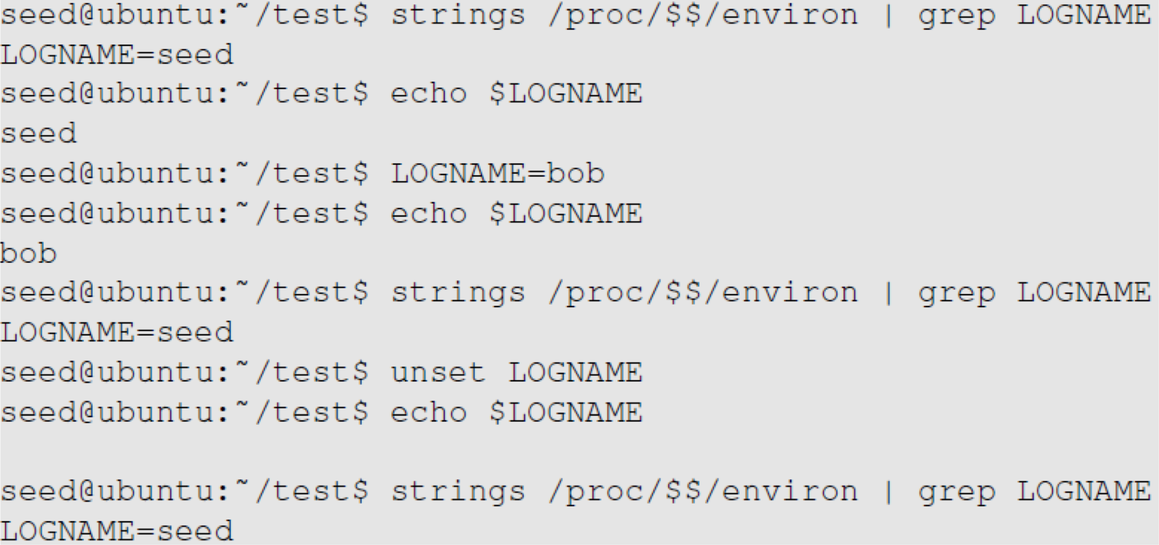
Shell Variables & Environment Variables
Shell variables and environment variables are different
When a shell program starts, it copies the environment variables into its own shell variables. Changes made to the shell variable will not reflect on the environment variables, as shown in example :
Environment variable
Shell variable
Shell variable is changed Environment variable is the same
Shell variable is gone Environment variable is still here
Notes:
$ before variable name is a dereference operator

Slide 11
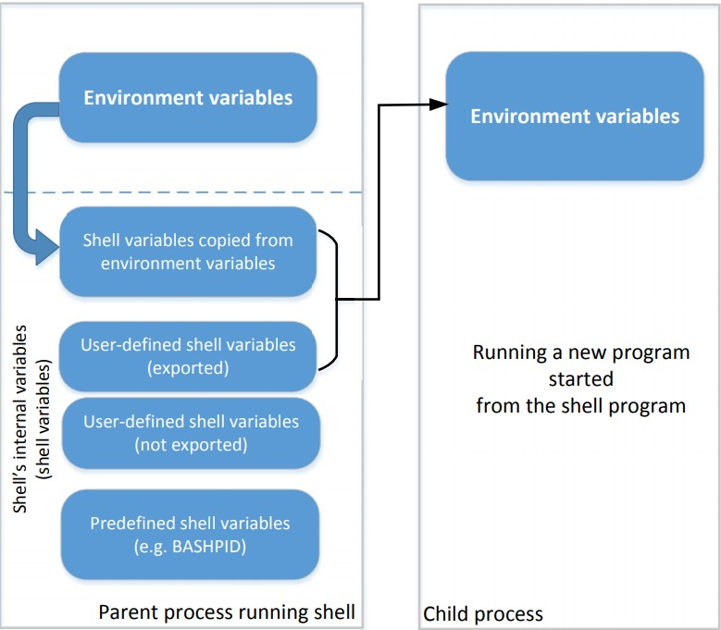
Shell Variables & Environment Variables
This figure shows how shell variables affect the environment variables of child processes
It also shows how the parent shell’s environment variables becomes the child process’s environment variables (via shell variables)
Notes:
Note what is shown above: for every process, there are default shell variables that store copies of the environment variables and marked for exportation!
Thus, environment variables are never directly copied to the child process environment variables directly, but rather through those default shell variables (that are by default marked for export) and user-defined (declared) shell variables that are explicitly marked for export via export command.

Slide 12
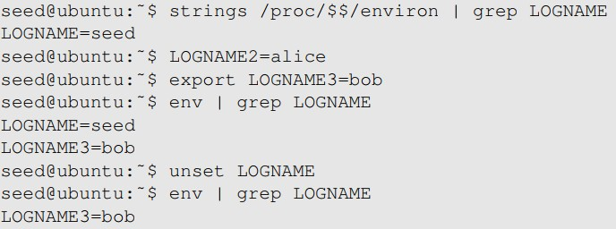
Shell Variables & Environment Variables
When we type env in shell prompt, shell will create a child process
Print out environment variable
Only LOGNAME and LOGNAME3
get into the child process, but not LOGNAME2. Why?
Notes:
Remember, running env command will spawn a child process and return the environment variables
Since the shell variable had the export command run on it, then when env was called, not only were default environment shell variables exported but also user-defined shell variables that were marked for export via export command.
Note: you can delete default shell variables (that store a copy of respective environment variable’s data); thus as shown above, unset LOGNAME thus deletes that default shell variable (which by default gets exported) storing an environment variable data; and so when env is called, LOGNAME is deleted but LOGNAME3 that was marked for export remained is the only data passed to env variables of the child process.

Slide 13
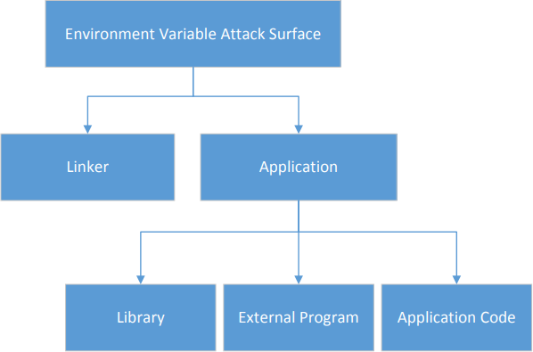
Attack Surface on Environment Variables
Hidden usage of environment variables is dangerous.
Since users can set environment variables, they become part of the attack surface on Set-UID programs.

Slide 14
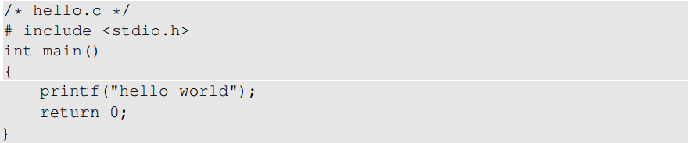
Attacks via Dynamic Linker
Linking finds the external library code referenced in the program
Linking can be done during runtime or compile time:
Dynamic Linking – uses environment variables, which becomes part of the attack surface
Static Linking (include library code as part of binary of the program)
We will use the following example to differentiate static and dynamic linking:
Notes:
NOTE: YOU NEED TO MAKE SURE YOU PAY ATTENTION TO ENV VARIABLES WHEN YOU COMPILE YOUR CODE!
On another machine, those ENV variables could point somewhere else and allow program to be compromised.
So, you need to not allow dynamic linking, but static, so that all programs found from ENV variables you specify on your machine that you originally compile the program on will find the code files from those paths stored by ENV variables and compile them into binaries and include them in the program
Notice program above, #include <stdio.h> relies on a ENV variable to find the stdio.h file
So, you want to statically link, yes, and it will be more space (which is why we allow dynamic linking, but causes more security risks).
See next slide
To find library code, linker relies on environment variables storing the path to that code.

Slide 15
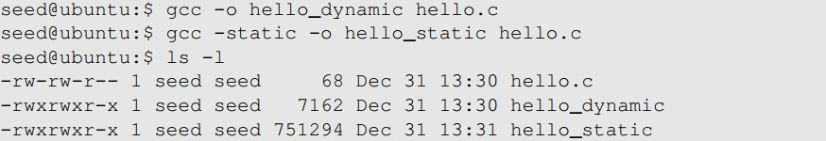
Attacks via Dynamic Linker
Static Linking
The linker combines the program’s code and the library code containing the printf() function
We can notice that the size of a static compiled program is 100 times larger than a dynamic program
Notes:
And, remember, programs need to be loaded into memory to run, thus statically linked compiled programs would be too large – note that the program includes stdio, which is very large library that contains links to other libraries which are all also included! So you can see how the file ends up huge!
So the idea is generally that you do not want to duplicate libraires (programs) if that same program/library will be used by several (hundreds of even) other programs/processes.
Also, if you statically compile libraries all the time, then if there was a patch needed for a given library, you would have to recompile every single program that uses that library with the updated library.
So, if you dynamically link, then you do not have this issue since env variables will point to those dynamically linked libraries; this is why it is called dynamic linking since it is a runtime linking process.
So although static is more secure in terms of reducing env variable attack vector, it has its downfalls.
Besides size, you do not always want to statically compile programs because it wastes a lot of memory to run several programs that use the same library, where it would be better if they could share those libraries in order to save memory
Also, if a library is updated, all programs that use the library would need to be recompiled.

Slide 16
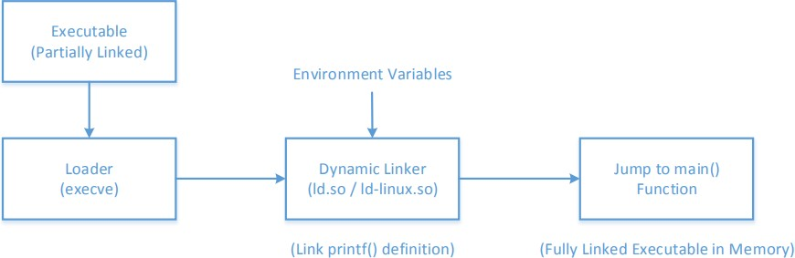
Attacks via Dynamic Linker
Dynamic Linking
The linking is done during runtime
Shared libraries (DLL (dynamically linked library) in Windows)
Before a program compiled with dynamic linking is run, its executable is loaded into the memory first
Notes:
Thus with DLLs, programs simply need to store only the variables in order load them into the dynamic library, rather than each program needing to load variables AND the code for the same library; the code portion is shared and stays in memory, and programs that use the library simply points there for the code of the DLL in memory but maintains its own variables (including variables specifically needed for that library).
Partially linked executable = only the code of the program + any statically linked programs that are part of the code.
.so stands for “shared object”
Note, above diagrams shows also how c++ compiler knows that program should start at main() function, as specified.
Problem with linker: out of developers control, which relies on environment variables to find libraries needed for a partially linked executable.
Problem: environment variables can be changed so that the linker points to a path to dynamic libraries of malicious code.
Partially linked executables have a certain file format with an interrupt embedded in order to call the linker at the given path specified (such as shown above ld.so/ld-linux.so
.so extension stands for “shared object” file type
Note that the dynamic linker itself is a shared object (dynamic library).
So, dynamic linker will search through the library of .so files and find the objects which contain the function called from a library by the main program.
Note: loader will load executable into memory and then pass control to dynamic linker when it runs the executable and hit the interrupt with the path to the dynamic linker.

Slide 17
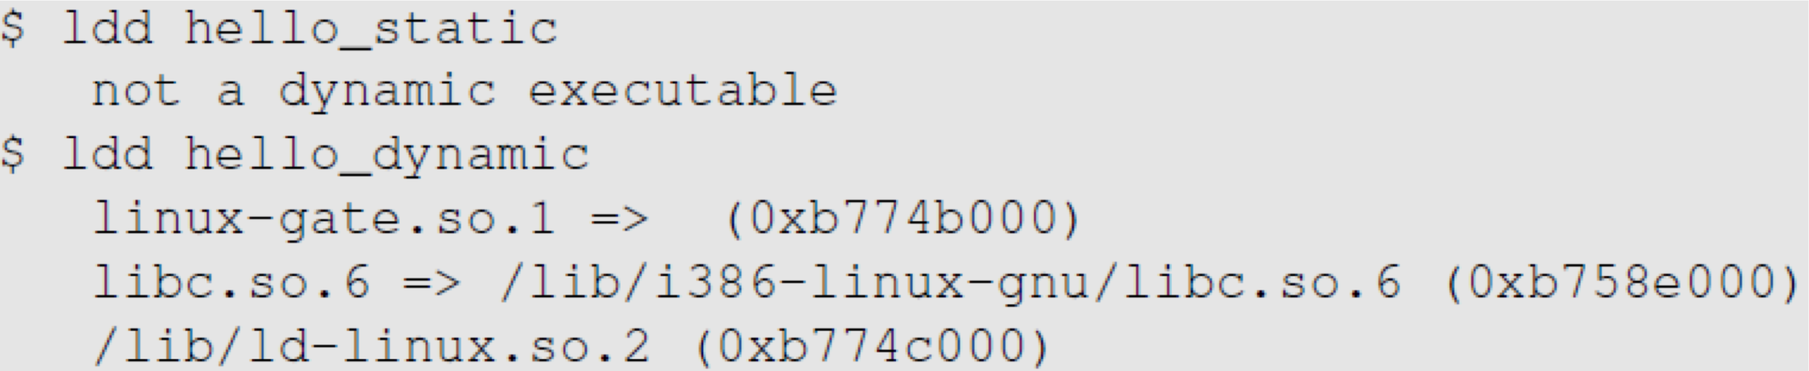
Attacks via Dynamic Linker
Dynamic Linking:
We can use “ldd” command to see what shared libraries a program depends on :
for system calls
The dynamic linker itself is in a shared library. It is invoked before the main function gets invoked.
The libc library (contains functions like printf() and sleep())

Slide 18
Attacks via Dynamic Linker: the Risk
Dynamic linking saves memory
This means that a part of the program’s code is undecided during the compilation time
If the user can influence the missing code, they can compromise the integrity of the program
Thus, dynamic linking takes away power from the developer to know how its code will be influenced/ran

Slide 19
Attacks via Dynamic Linker: Case Study 1
LD_PRELOAD contains a list of shared libraries which will be searched first by the linker – these libraries are often used, hence they are checked first (and likely they are already in memory being used by another process)
If not all functions are found, the linker will search among several lists of folder including the one specified by LD_LIBRARY_PATH
Both variables can be set by users, so it gives them an opportunity to control the outcome of the linking process
If that program were a Set-UID program, it may lead to security breaches
Notes:
Environment variables contain PATHS to shared libraries.

Slide 20
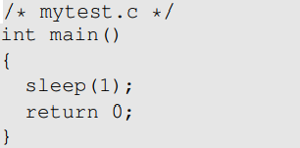

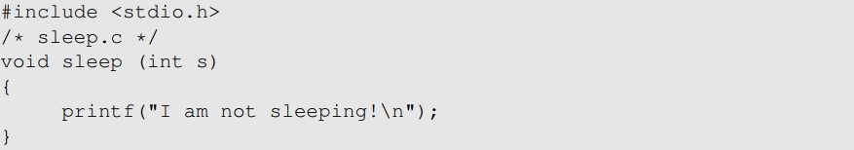
Attacks via Dynamic Linker: Case Study 1
Example 1 – Normal Programs:
Program calls sleep function which is dynamically linked:
Now we implement our own sleep() function:

Slide 21
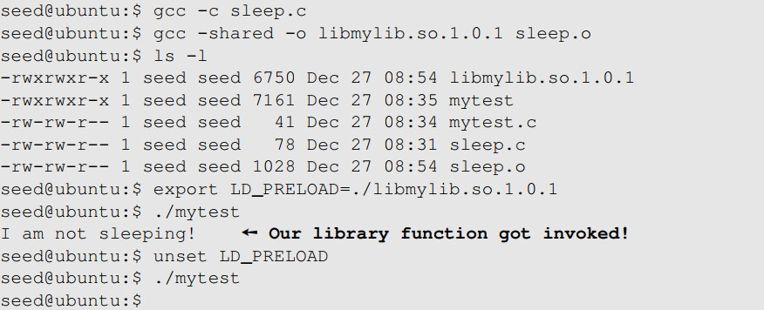
Attacks via Dynamic Linker: Case Study 1
Example 1 – Normal Programs ( continued ):
We need to compile the above code, create a shared library and add the shared library to the LD_PRELOAD environment variable
Notes:
Shared object created with sleep.o code included; then it is stored in a shell variable, then the shell variable is turned into an environment variable (via export) so that child processes will inherit the paths of this environment variable; then mytest is called and you see sleep() from the created .so shared object to which there is a path to this variable from the shell variable loaded is used instead of the original .so shared object library; then after the preload variable is deleted (unset), then the normal library with the normal sleep() function is then invoked like it should as normal/default.

Slide 22
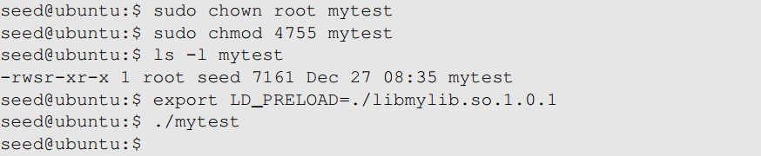
Attacks via Dynamic Linker: Case Study
Example 2 – Set-UID Programs:
If the technique in example 1 works for Set-UID program, it can be very dangerous. Lets convert the above program into Set-UID :
Our sleep() function was not invoked.
This is due to a countermeasure implemented by the dynamic linker. It ignores the LD_PRELOAD and LD_LIBRARY_PATH environment variables when the EUID and RUID differ.
Lets verify this countermeasure with an example in the next slide.

Slide 23
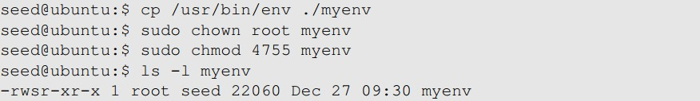
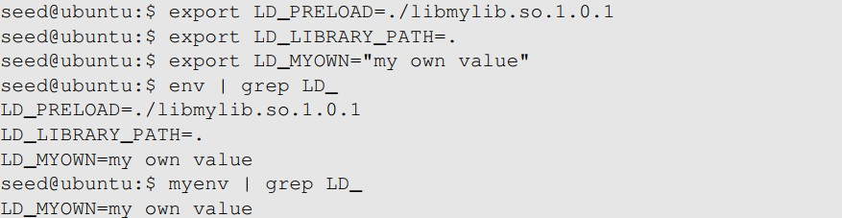
Attacks via Dynamic Linker
Let’s verify the countermeasure
Make a copy of the env program and make it a Set-UID program :
Export LD_LIBRARY_PATH and LD_PRELOAD and run both the programs:
Run the original
env program
Run our env
program
Notes:
myenv program is a setUID program so you notice output was different because countermeasure kicked in

Slide 24
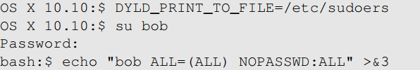
Attacks via Dynamic Linker: Case Study 2
Case study: OS X Dynamic Linker
As discussed in Chapter 1 (in capability leaking ), apple OS X 10.10 introduced a new environment variable without analyzing its security implications perfectly.
DYLD_PRINT_TO_FILE
Ability for users to supply filename for dyld
If it is a Set-UID program, users can write to a protected file
Capability leak – file descriptor not closed
Exploit example:
Set DYLD_PRINT_TO_FILE to /etc/sudoers
Switch to Bob’s account
The echo command writes to /etc/sudoers
Notes:
Log of dynamic linker program output sent to DYLD_PRINT_TO_FILE file.\
Now bob has root access

Slide 25
Attacks via External Program
An application may invoke an external program.
The application itself may not use environment variables, but the invoked external program might.
Typical ways of invoking external programs:
exec() family of function which call execve(): runs the program directly
system()
The system() function calls execl()
execl()eventually calls execve()to run /bin/sh
The shell program then runs the program
Attack surfaces differ for these two approaches
We have discussed attack surfaces for such shell programs in Chapter 1. Here we will focus on the Environment variables aspect.
Notes:
Execve() → run program directly within the current process (do not spawn child)

Slide 26
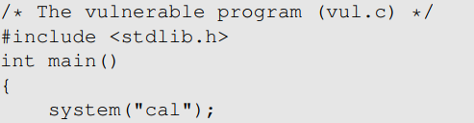
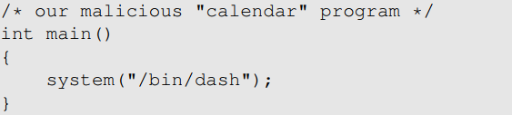
Attacks via External Program: Case Study
Shell programs behavior is affected by many environment variables, the most common of which is the PATH variable.
When a shell program runs a command and the absolute path is not provided, it uses the PATH variable to locate the command.
Consider the following code:
Full path not provided. We can use this to manipulate the path variable
We will force the above program to execute the following program :

Slide 27
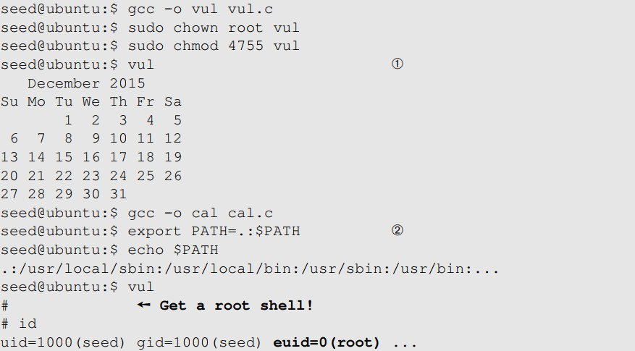
Attacks via External Program: Case Study
We will first run the first program without doing the attack
We now change the PATH environment variable
Notes:
For the attack:
We export path, but we before making it an export variable, we add current directory (.) as first path to check from the environment variable.

Slide 28
Attacks via External Program: Attack Surfaces
Compared to system(), execve()’s attack surface is smaller
execve() does not invoke shell, and thus is not affected by environment variables
When invoking external programs in privileged programs, we should use execve()
Refer to Chapter 1 for more information

Slide 29
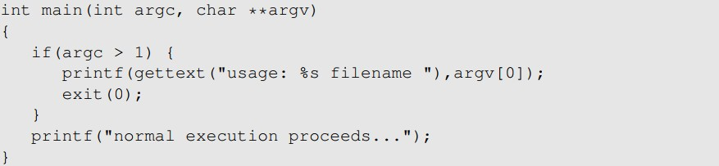
Attacks via Library
Programs often use functions from external libraries. If these functions use environment variables, they add to the attack surface
Case Study – Locale in UNIX
Every time a message needs to be printed out, the program uses the provided library functions for the translated message
Unix uses the gettext() and catopen() in the libc library
The following code shows how a program can use locale subsystem :
Notes:
Note, Locale is a language library that supports translating text from one language to another.

Slide 30
Attacks via Library
This subsystem relies on the following environment variables : LANG, LANGUAGE, NLSPATH, LOCPATH, LC_ALL, LC_MESSAGES
These variables can be set by users, so the translated message can be controlled by users.
Attacker can use format string vulnerability to format the printf()
function – More information in chapter 6
Countermeasure:
This lies with the library author
Example: Conectiva Linux using the Glibc 2.1.1 library explicitly checks and ignored the NSLPATH environment variable if catopen() and catgets() functions are called from a Set-UID program

Slide 31
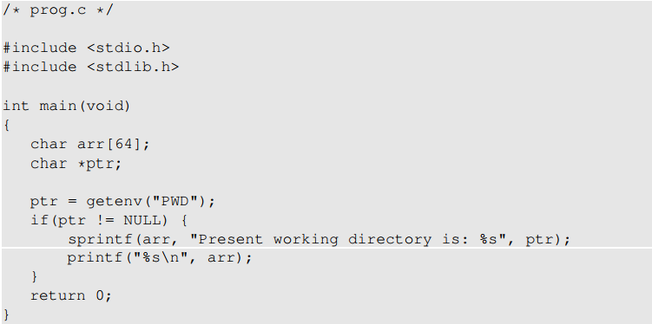

Attacks via Application Code
Programs may directly use environment variables. If these are privileged programs, it may result in untrusted inputs.
Notes:
Getenv(“PWD”) returns the path that is stored in the PWD env variable.
Sprintf is the “string print function”, which outputs strings combined into another string; for example, as shown above, “present working directory is” + the string stored in ptr will be combined and stored into arr.
Above program has an issue: can lead to buffer overflow if user gives input longer than 64 bytes.

Slide 32
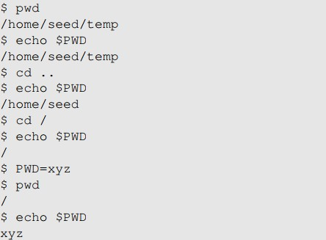
Attacks via Application Code
The program uses getenv() to know its current directory from the PWD environment variable
The program then copies this into an array “arr”, but forgets to check the length of the input. This results in a potential buffer overflow.
Value of PWD comes from the shell program, so every time we change our folder the shell program updates its shell variable.
We can change the shell variable ourselves.
Current directory with unmodified shell variable
Current directory with modified shell variable
Notes:
REMEMBER: IF a program is called from shell, a NEW (child) process is spawned.
And child process will inherit all environment variables (default export variables) and user-defined exported variables.
So we can get buffer overflow by setting PWD variable to a very long string.

Slide 33
Attacks via Application Code - Countermeasures
When environment variables are used by privileged Set-UID programs, they must be sanitized properly.
Developers may choose to use a secure version of getenv(), such as secure_getenv().
getenv() works by searching the environment variable list and returning a pointer to the string found, when used to retrieve a environment variable.
secure_getenv() works the exact same way, except it returns NULL when “secure execution” is required.
Secure execution is defined by conditions like when the process’s user/group EUID and RUID don’t match (AKA when a setUID program is ran)

Slide 34
Set-UID Approach VS Service Approach
Normal-User Process
Privileged Process
Environment Variables
Environment Variables
Request for service
Privileged Process
(Conduct privileged operations for users)
Privileged Process
(Conduct privileged operations for users)
Normal User Process
(a) Set-UID Approach
(b) Service Approach
Notes:
Windows uses the service-based approach
-environment variables not accessible by user; rather they are consumed by a privileged process which the user program calls as a service, which is where problems can arrive for Windows.

Slide 35
Set-UID Approach VS Service Approach
Most operating systems follow two approaches to allow normal users to perform privileged operations
Set-UID approach: Normal users have to run a special program to gain root privileges temporarily
Service approach: Normal users have to have to request a privileged service to perform the actions for them. Figure in the earlier slide depicts these two approaches
Set-UID has a much broader attack surface, which is caused by environment variables
Environment variables cannot be trusted in Set-UID approach
Environment variables can be trusted in Service approach
Although, the other attack surfaces still apply to Service approach (Discussed in Chapter 1), it is considered safer than Set-UID approach
Due to this reason, the Android operating system completely removed the Set- UID and Set-GID mechanism
Notes:
Generally, the setUID approach is better; because in Windows, a background service (process) has to always be running in order to manage a programs access to environment variables (which means Windows is always consuming resources, while SetUID is on demand and thus has better performance.
However, setUID approach has a much broader attack surface.
Environment variables come from the privileged trusted process (service) in the Windows service approach.
Thus you must compromise the parent process in order to compromise other programs based on environment variables.
But this is under assumption that the service is a trusted and secure process.

Slide 36
Summary
What are environment variables
How they get passed from one process to its children
How environment variables affect the behaviors of programs
Risks introduced by environment variables
Case studies
Attack surface comparison between Set-UID and service approaches

